Slide 1


STATE-OWNED PROPERTIES:
CHALLENGES AND OPPORTUNITIES
MELINA LODGE
SEPTEMBER 18, 2023

Slide 2
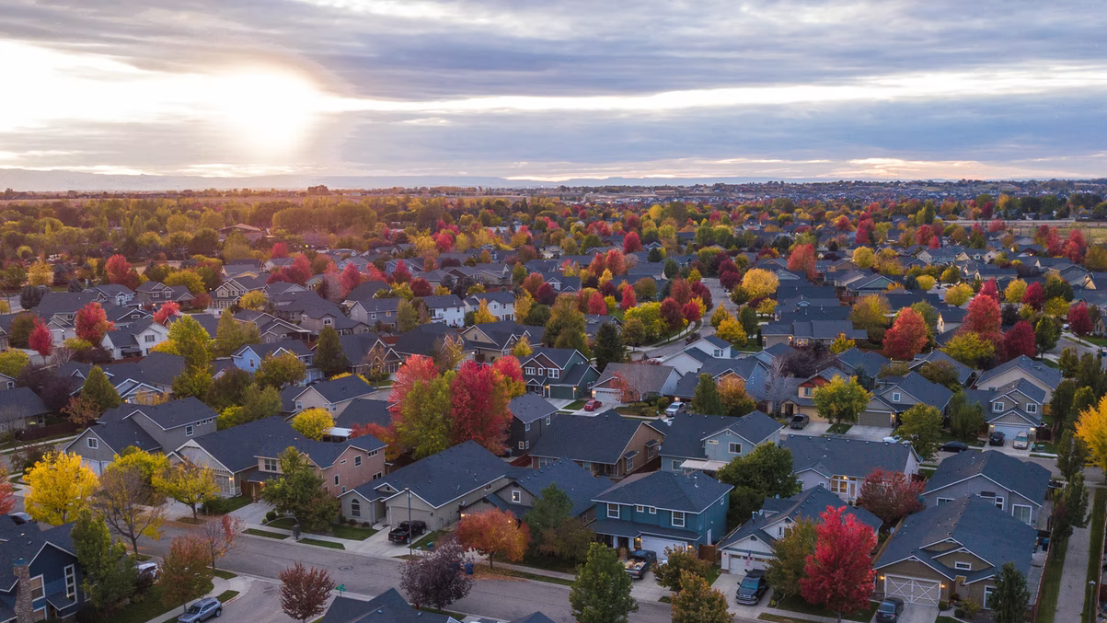
ABOUT
The Housing Network ﻿of Rhode Island is the state’s membership organization of 14 community development corporations and nonprofit housing developers across Rhode Island. Our members have long-standing commitments to the communities they serve, which they put into action by developing affordable homes and responsive resident-centered programming.

Slide 3

















MEMBERS

Slide 4



In addition to supporting our members, HNRI:
  Administers a Down Payment and Closing Cost Assistance program for the City of Providence
  Supports Community and Civic Engagement Activities
  Coordinates a centralized, statewide HUD-Approved Homebuyer and Landlord Education program
As part of our advocacy, the Housing Network of Rhode Island facilitates Homes RI, a multi-sector coalition of organizations working together to increase and preserve the supply of safe, healthy and affordable homes throughout Rhode Island.
In 2005 the Network incorporated the Community Housing Land Trust of RI, the first statewide land trust in the country, with a mission of ensuring a supply of permanently affordable housing for generations of Rhode Islanders in perpetuity.

Slide 5
EXPERIENCE WITH STATE-OWNED PROPERTIES
  Polled membership and no one reported ever being outreached to regarding state properties available for re-development
  Lack of centralized information (public facing) regarding the inventory of state owned properties

Slide 6
EXPERIENCE WITH STATE-OWNED PROPERTIES
Recommendations:
Adopt a policy that prioritizes the redevelopment of state-owned properties for affordable housing
Creation of a public facing centralized list that includes: address; current use of property; surrounding uses; description of property condition; underlying zoning and what type of development is permissible by-right
Create a staff position within the appropriate state entity responsible for managing list and proactive outreach

Slide 7
RIGHT OF FIRST REFUSAL (ROFR)
CURRENT APPLICATION
Municipalities currently have a ROFR when the state-owned properties become available, however as written
    No commitment to redevelopment as housing
    Timeframe for execution is unrealistic at only 30 days. Generally, municipalities require voter approval to acquire creating additional procedural and administrative process
    Goal of disposition of properties is to generate the highest pay-out

Slide 8
RIGHT OF FIRST REFUSAL (ROFR)
GROUP HOME EXAMPLE
Over the last 5 years, we have seen many of the State’s group homes be sold off to the highest bidder
  Group homes are counted towards a municipalities 10% so the sale for non LMIH uses impacts municipalities
  Puts additional pressure on the housing market ~ congregate to non congregate, not replacing with like housing stock

Slide 9
RIGHT OF FIRST REFUSAL (ROFR)
REFORM SUGGESTION
Propose that RIHousing be given ROFR
Require existing residential properties be utilized for LMIH
Require non-residential properties to be prioritized for residential use with required affordability component
Valuation based on the lesser of fair market value or appraised value
    Even better - no cost if used for LMIH

Slide 10
BARRIERS WITH STATE-OWNED PROPERTIES
Lack information and coordination
Deferred maintenance
    Condition of properties means rehabilitation is often cost-prohibitive
Underlying land use
    Local land use requirements may restrict redevelopment opportunities
NIMBYism
    Neighbors’ opposition to development, particularly if affordable housing is component
Financial resources
    Need dedicated funding targeted to redevelopment of state properties as affordable housing

Slide 11
NATIONAL AND REGIONAL EXAMPLES
HOW ARE STATE-OWNED PROPERTIES TREATED IN OTHER PLACES?
State Level - Washington, California, Florida, District of Columbia
County Level – King County, WA; Cook County, IL
City Level - Atlanta, GA; Chicago, IL; Jacksonville, FL; New York City, NY; Port Townsend, WA; Redmond, WA; Seattle, WA; San Francisco, CA

Slide 12


QUESTIONS?
For questions or more information, contact:
Melina Lodge, Executive Director
mlodge@housingnetworkri.org
401-721-5680 x 104
@HousingNetwrkRI
@housingnetworkri
housingnetworkri.org

